Slide 1
Micron Bendemeer
Application Study
Sean Lam
23 Oct 2023

Slide 2
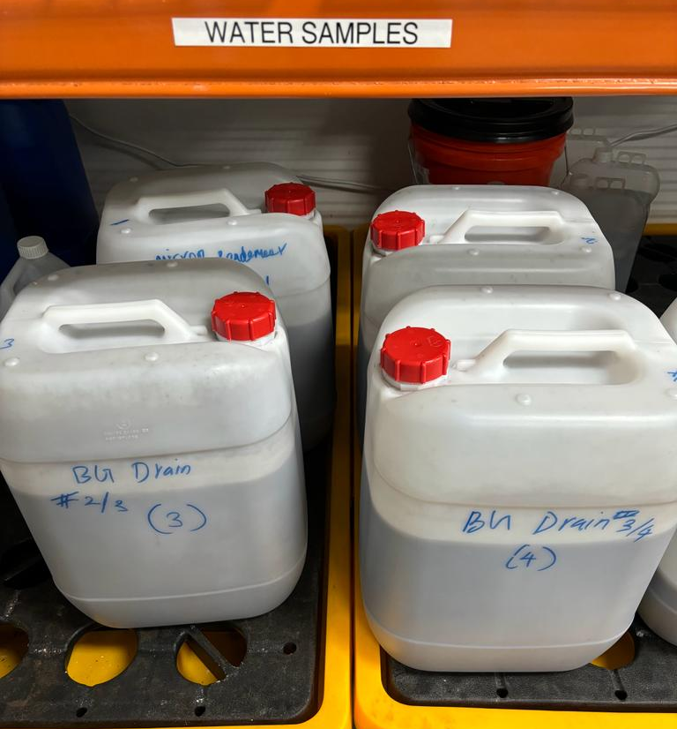
Lab-Test Objectives
To analyze incoming wastewater streams quality
To conduct jar test to determine treatment process to reduce turbidity, TSS, SiO2 to meet downstream process quality requirements
Observation: Bulging of carboys after collection → hydrogen generation

Slide 3
Waste Streams Composition (22 Sep 2023)
 | Dicing & BG1 | BG2 | BG3 | BG4 | BGA RO Conc
*pH | 7.16 | 7.49 | 7.27 | 7.18 | 7.51
Total Alkalinity, CaCO3 mg/L | 6.25 | 8.75 | 2.5 | 7.5 | 3.75
*Conductivity, μS/cm | 32.2 | 60.6 | 14.9 | 48.2 | 9.75
*Turbidity, NTU | 6,980 | 4,680 | 10,880 | 8,100 | 9.26
*TSS, mg/L | 3,550 | 2,360 | 5,940 | 4,610 | 7
*Total Silica, mg/L | 85.2 | 243 | 330 | 791 | 0.847
Dissolved Silica, mg/L | 82.6 | 288 | 293 | 505 | NA
TOC, mg/L | 2.23 | 2.03 | 1.66 | <1 | <1
COD, O2 mg/L | <3 | <3 | <3 | <3 | <3
Note: High Turbidity, TSS and Total Silica in Dicing & Backgrind streams
*Focus on these 5 parameters in subsequent tests

Slide 4
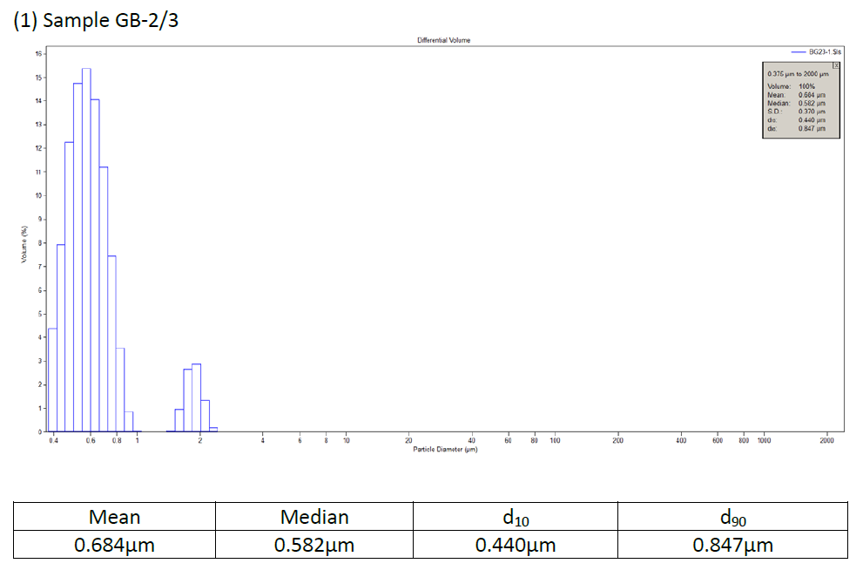
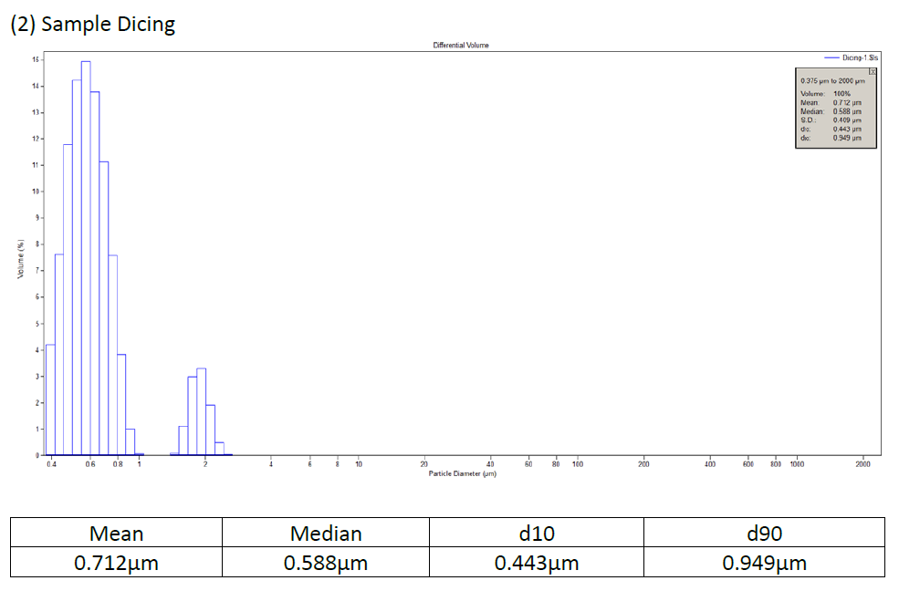
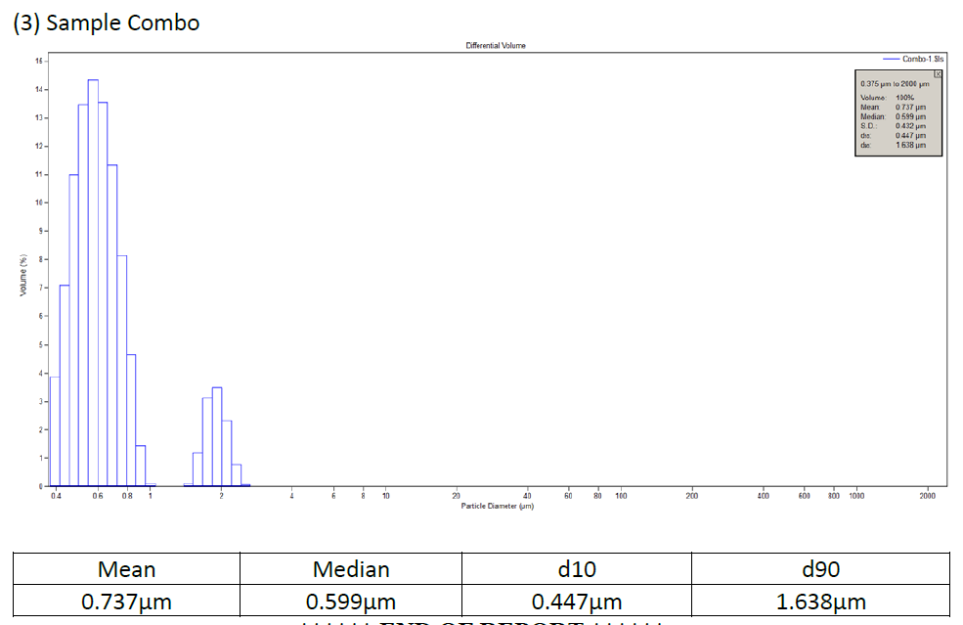
Particle Size Distribution (09 Oct 2023)
Sample | Dicing | BG-2/3 | Combo
d10, μm | 0.443 | 0.440 | 0.447
Median, μm | 0.588 | 0.582 | 0.599
Mean, μm | 0.712 | 0.684 | 0.737
d90, μm | 0.949 | 0.847 | 1.638

Slide 5
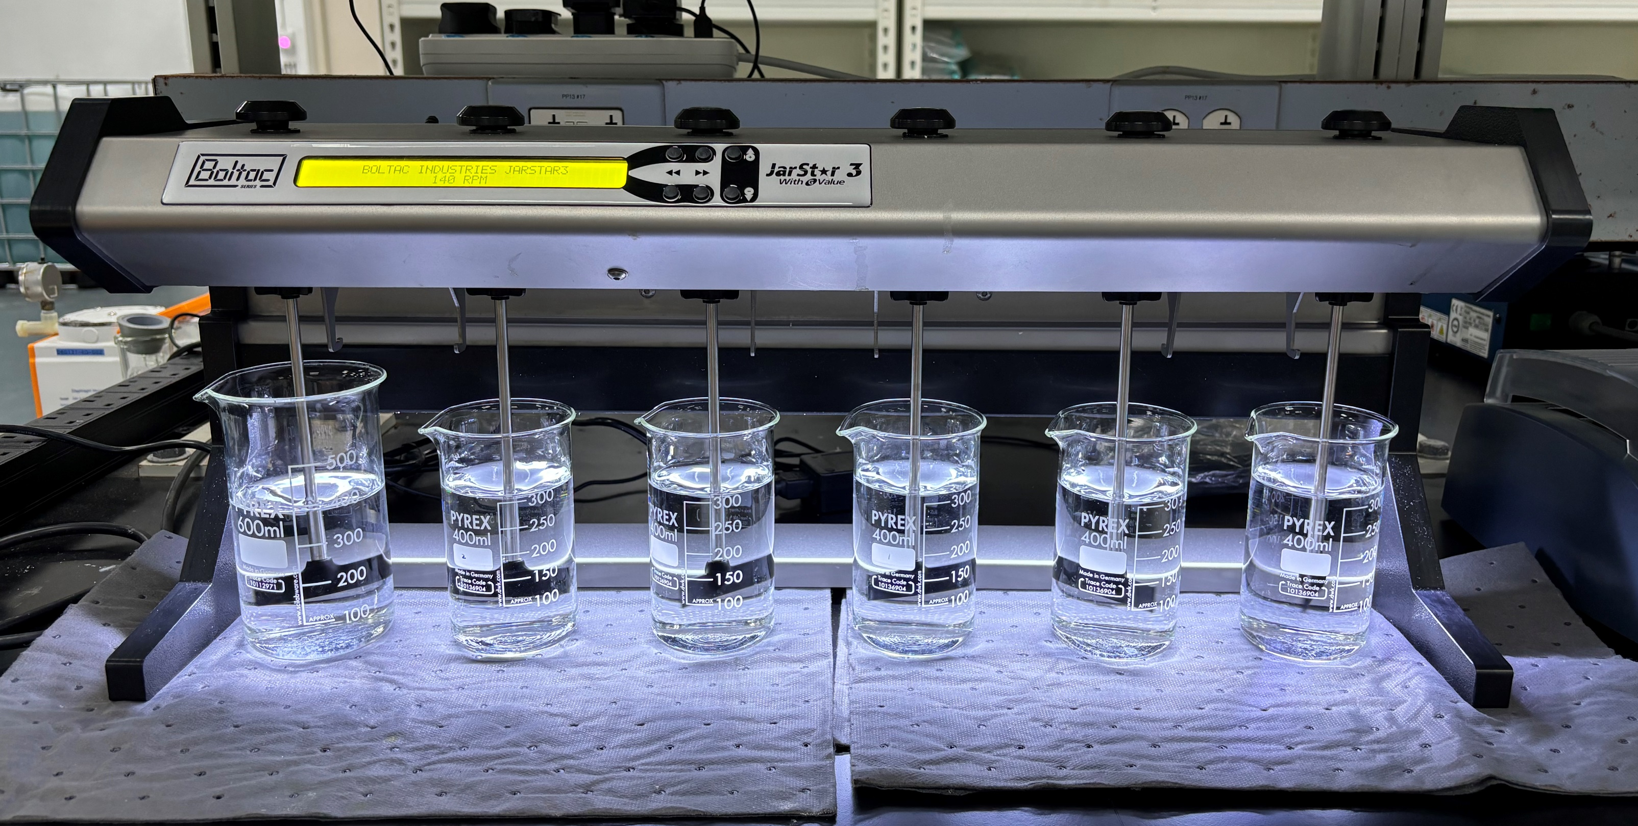
Jar Test Plan
Parameter | Alum | PAC | FeCl3 | MgCl2
Feed | Combined Dicing & Backgrind waste streams
Coagulant | Aluminum Sulfate (Alum) | Polyaluminum Chloride (PAC) | Ferric chloride (FeCl3) | Magnesium chloride (MgCl2)
Coagulant Dosage | 50-250 mg/L | 50-250 mg/L | 350-950 mg/L | 650-2,400 mg/L
pH | 5.5-8.5 | 5.5-8.5 | 8.5-9.0 | 10.5-11.0
Polymer Dosage | 1-2 ppm
Collect samples for analysis: (i) Feed (Control); (ii) Supernatant; (iii) Filtered Supernatant (0.45μm)

Slide 6
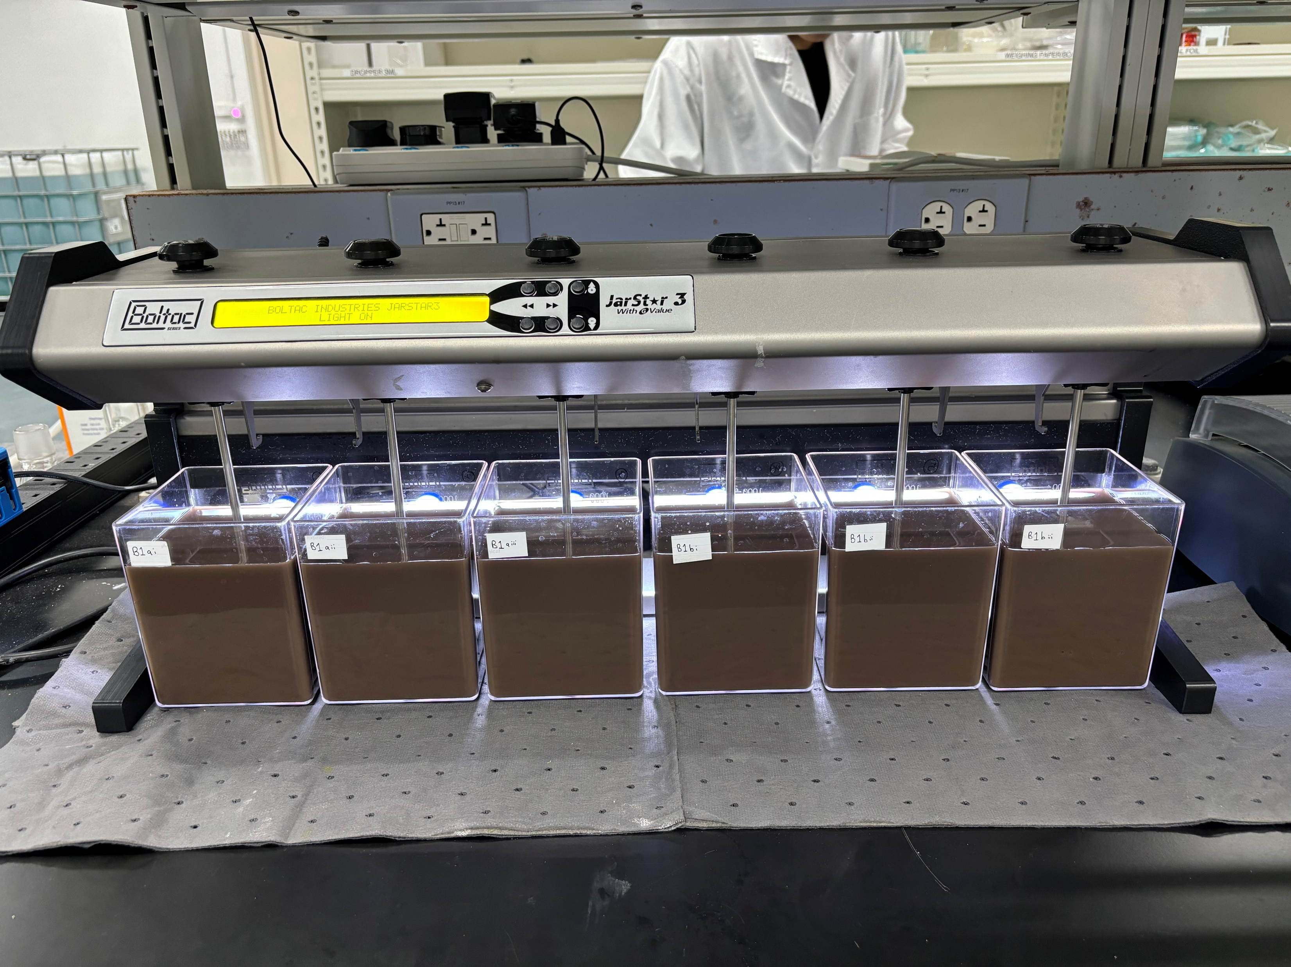
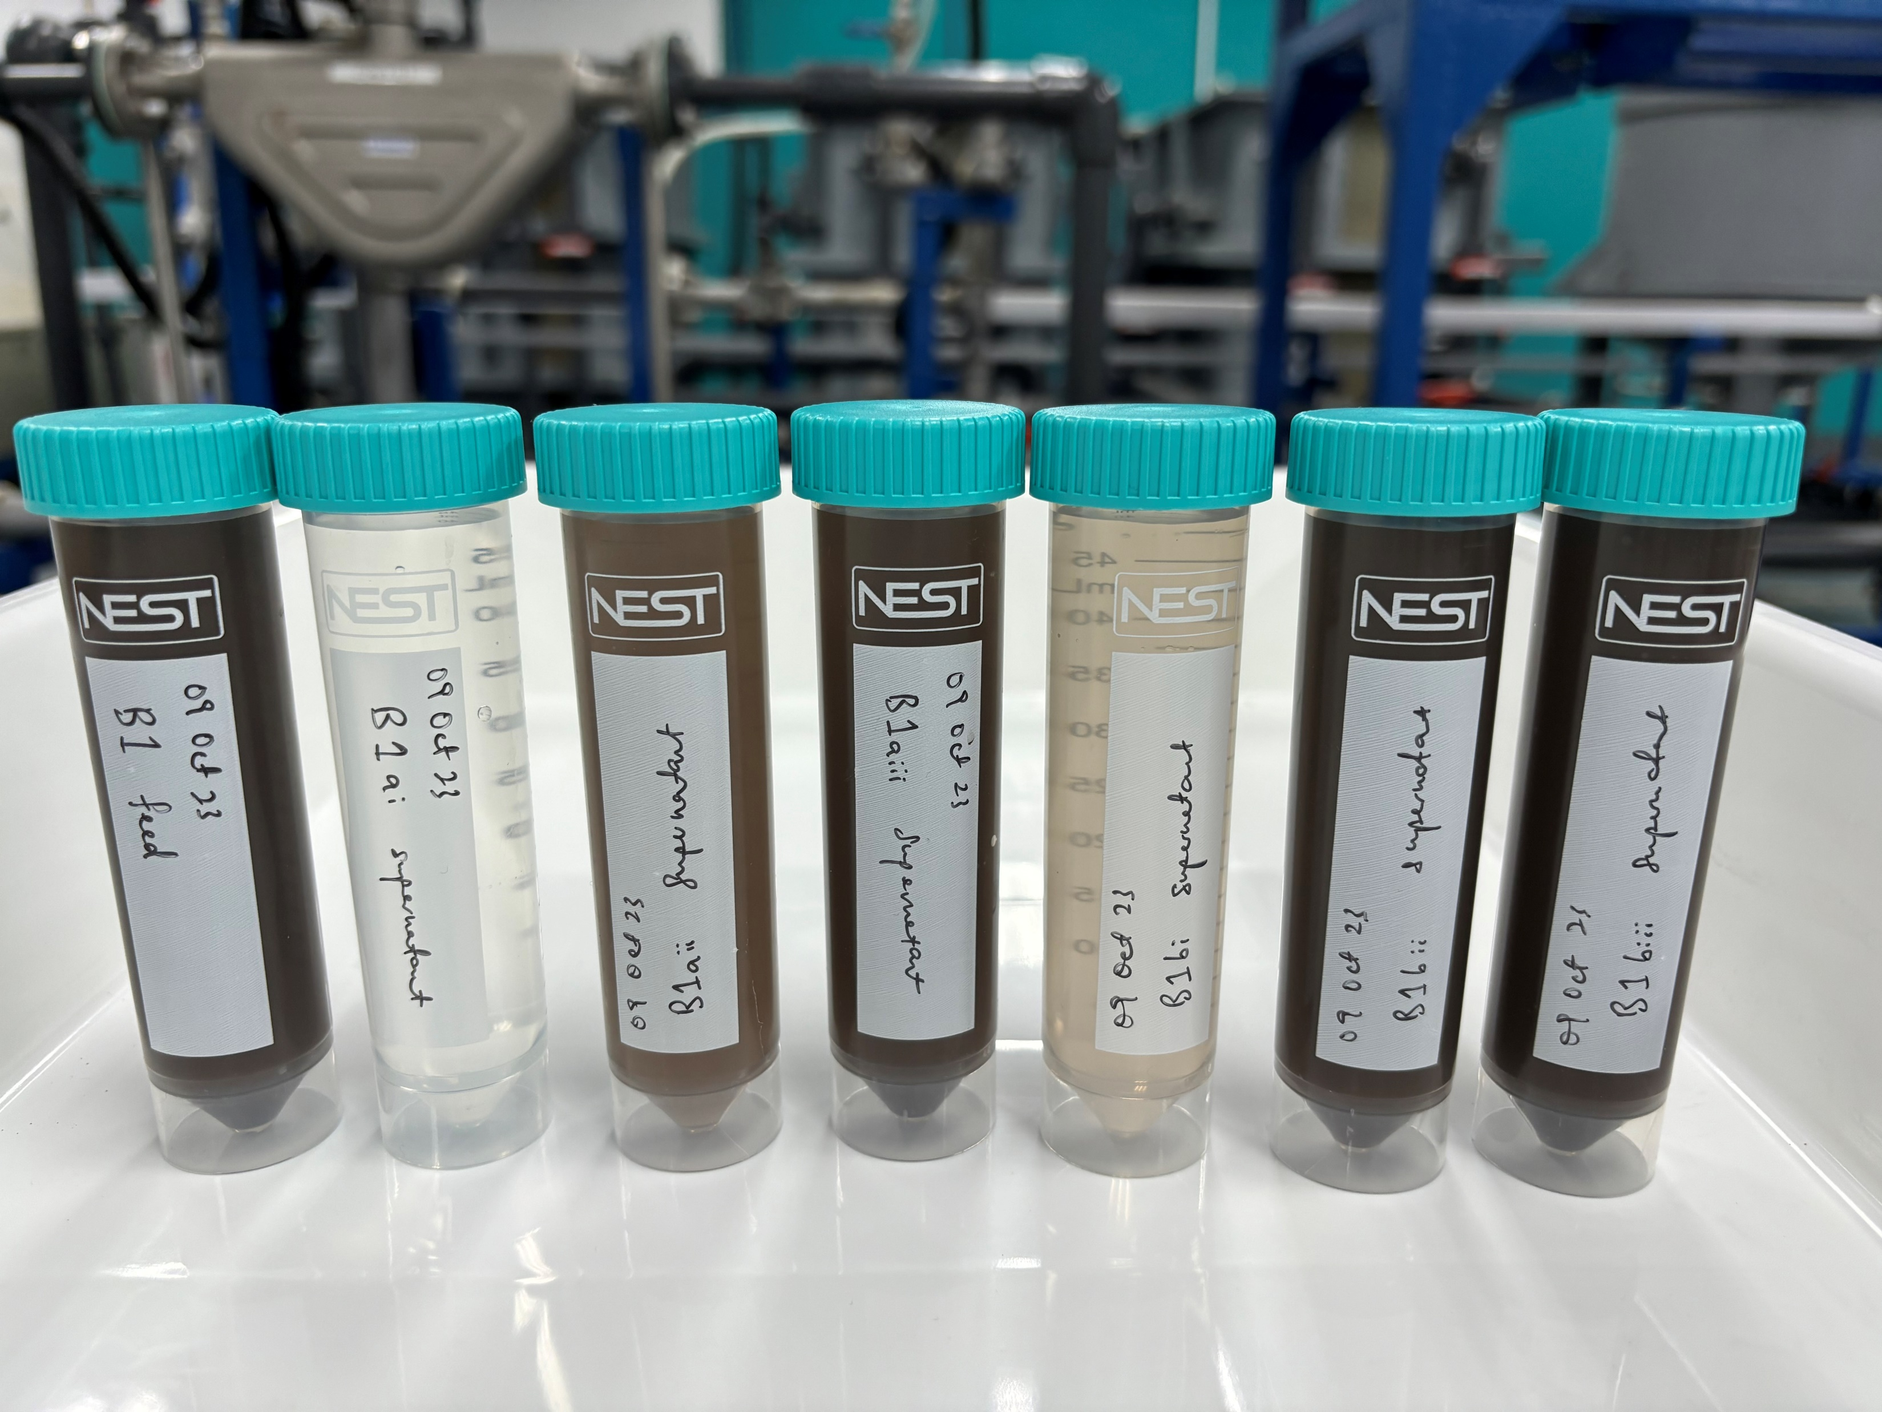
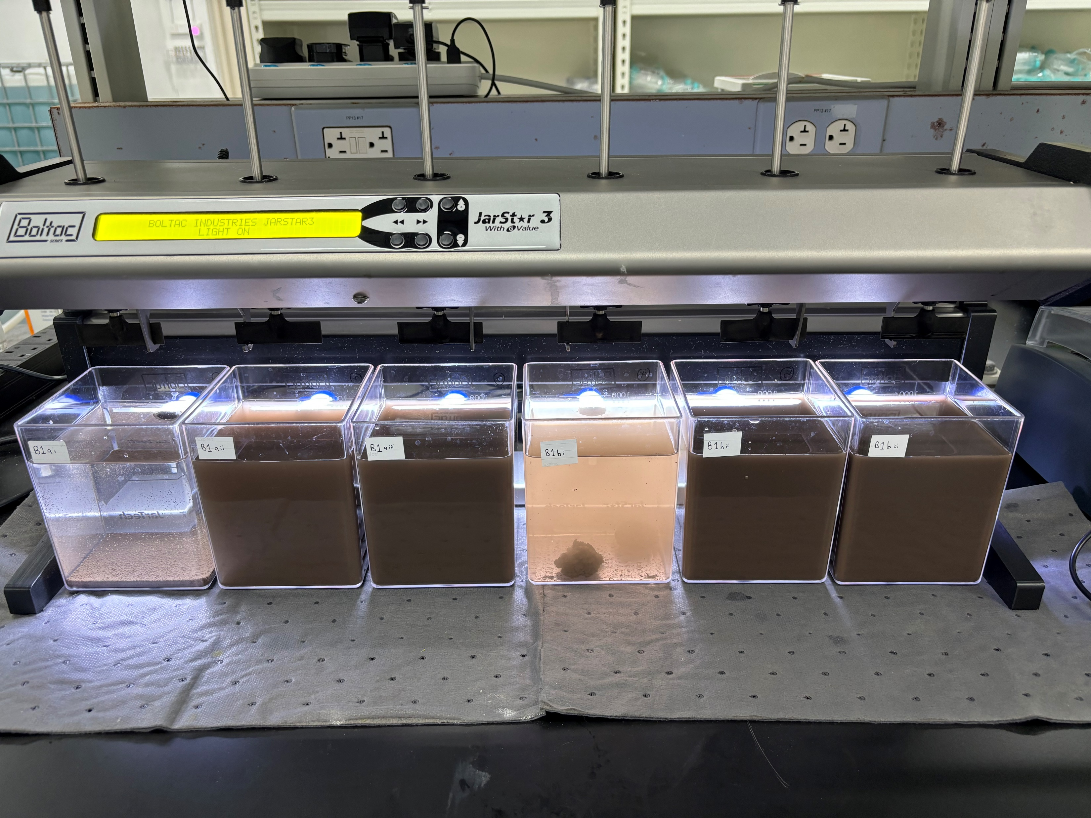
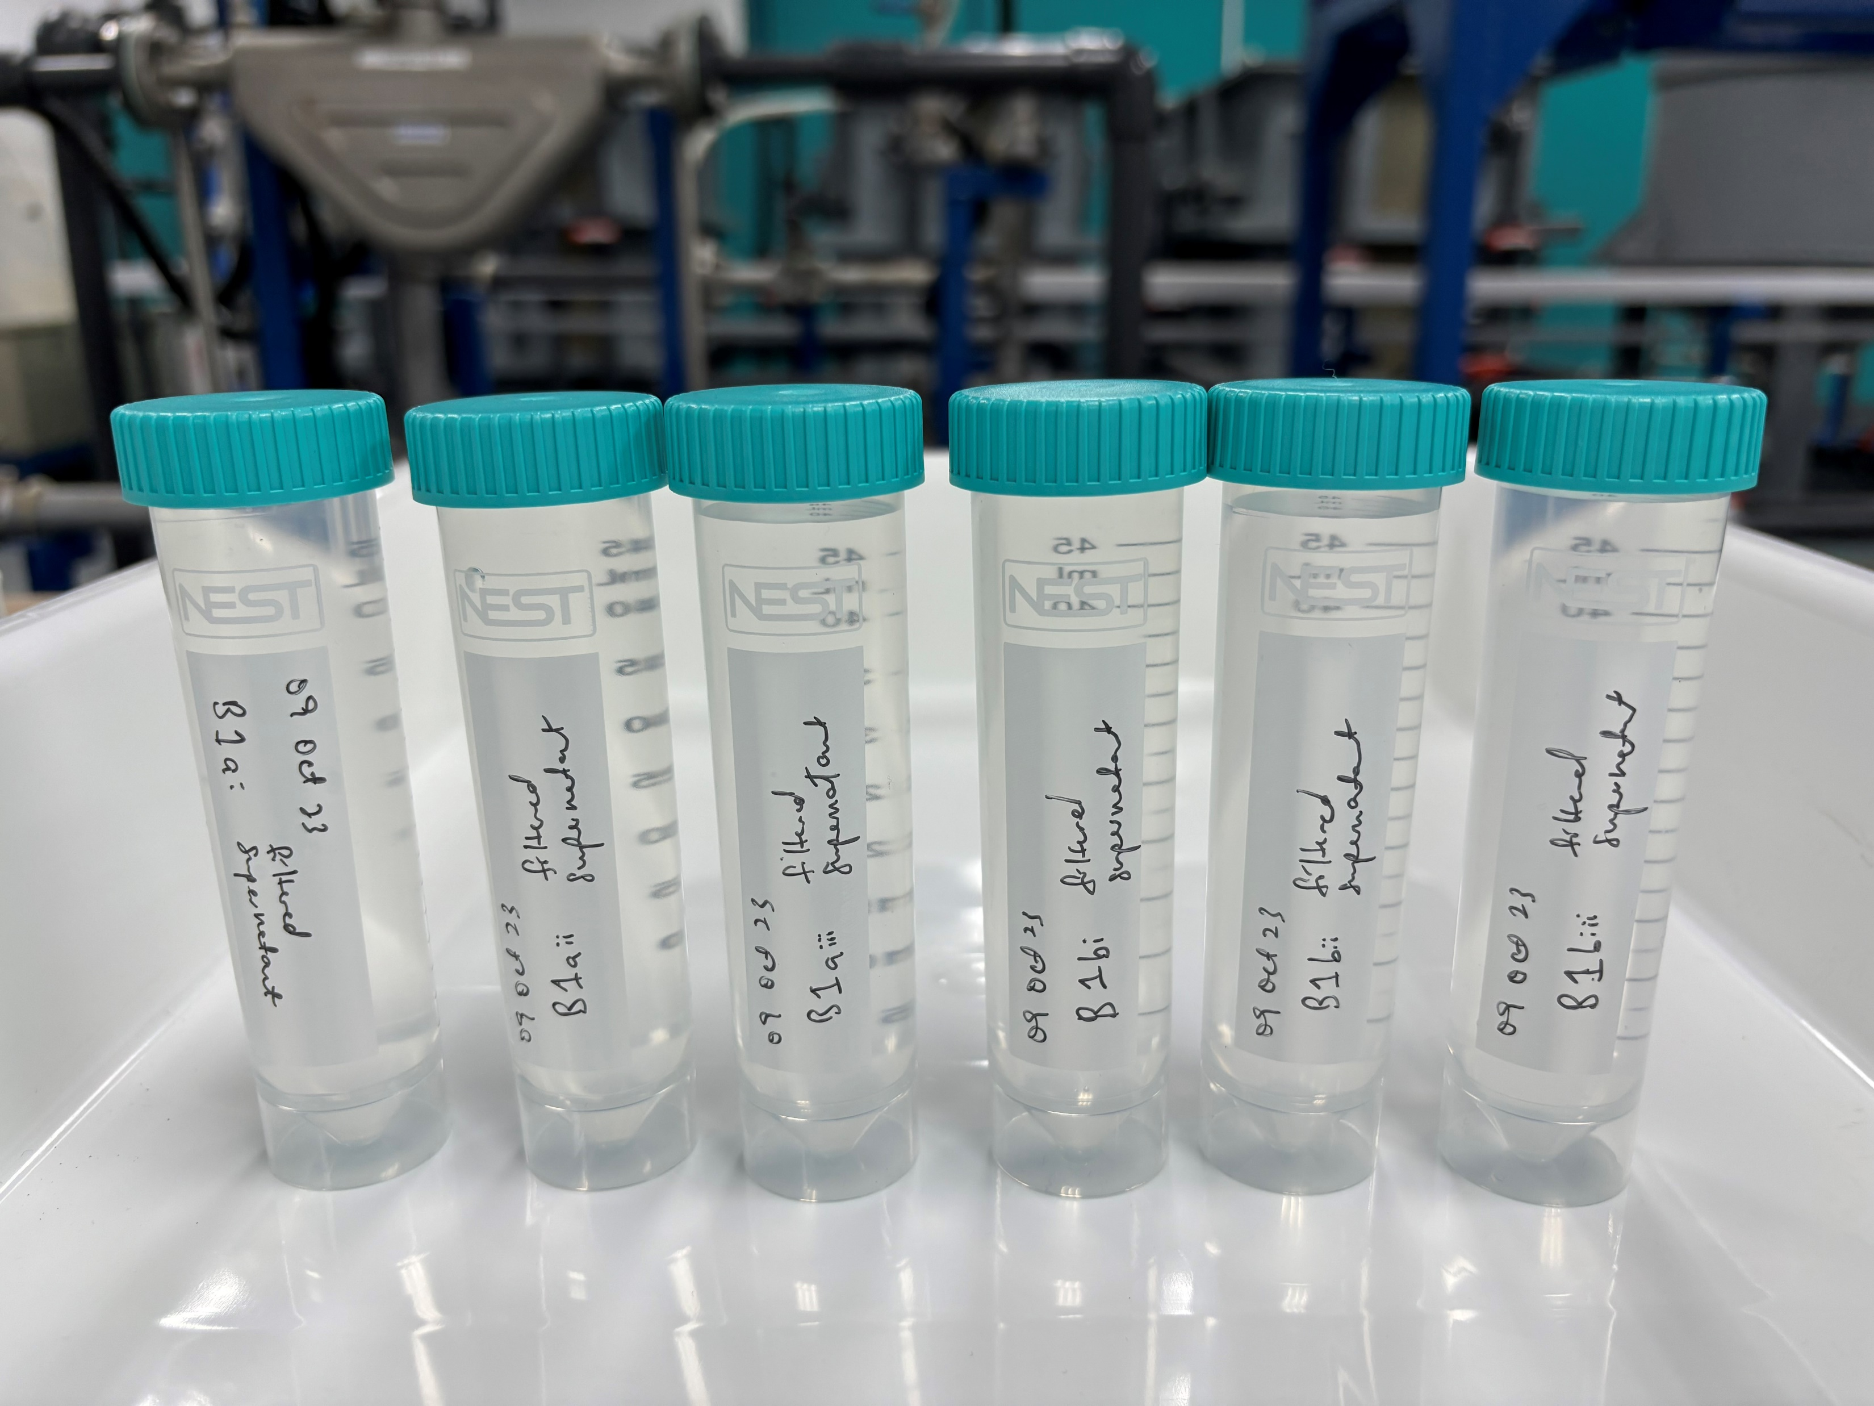
Experiment – Combo Feed with Alum
Initial
Final
Collect samples for analysis: (i) Feed (Control); (ii) Supernatant; (iii) Filtered Supernatant (0.45μm)
Alum 50-250mg/L
pH 5.5-8.5

Slide 7
Results – Combo Feed with Alum
 | Control | Alum Dose-1 |  | Alum Dose-2 |  | Alum Dose-3
 | Feed | Supernatant | *Filtered Supernatant | Supernatant | *Filtered Supernatant | Supernatant | *Filtered Supernatant
pH | 7.51 | 6.58 | 6.33 | 6.7 | 6.81 | 8.98 | 8.94
Turbidity, NTU | 6,820 | 13 | 1.73 | 1,180 | 0.74 | 2,140 | 2.42
TSS, mg/L | 3,470 | 5 | <3 | 690 | <3 | 1,090 | <3
Total Silica, mg/L | 560 | 156 | 159 | 268 | 148 | 378 | 142
Conductivity, μS/cm | 42 | 140 | 138 | 170 | 159 | 175 | 178
*Filtered Supernatant (0.45μm)

Slide 8
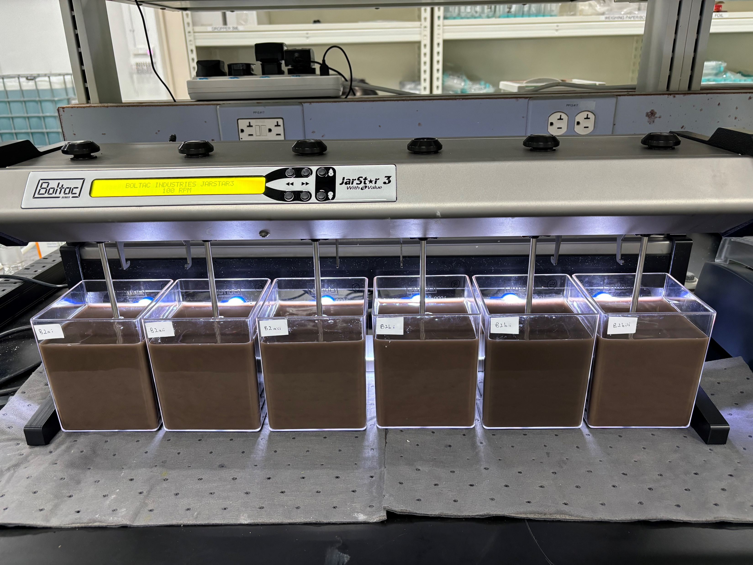
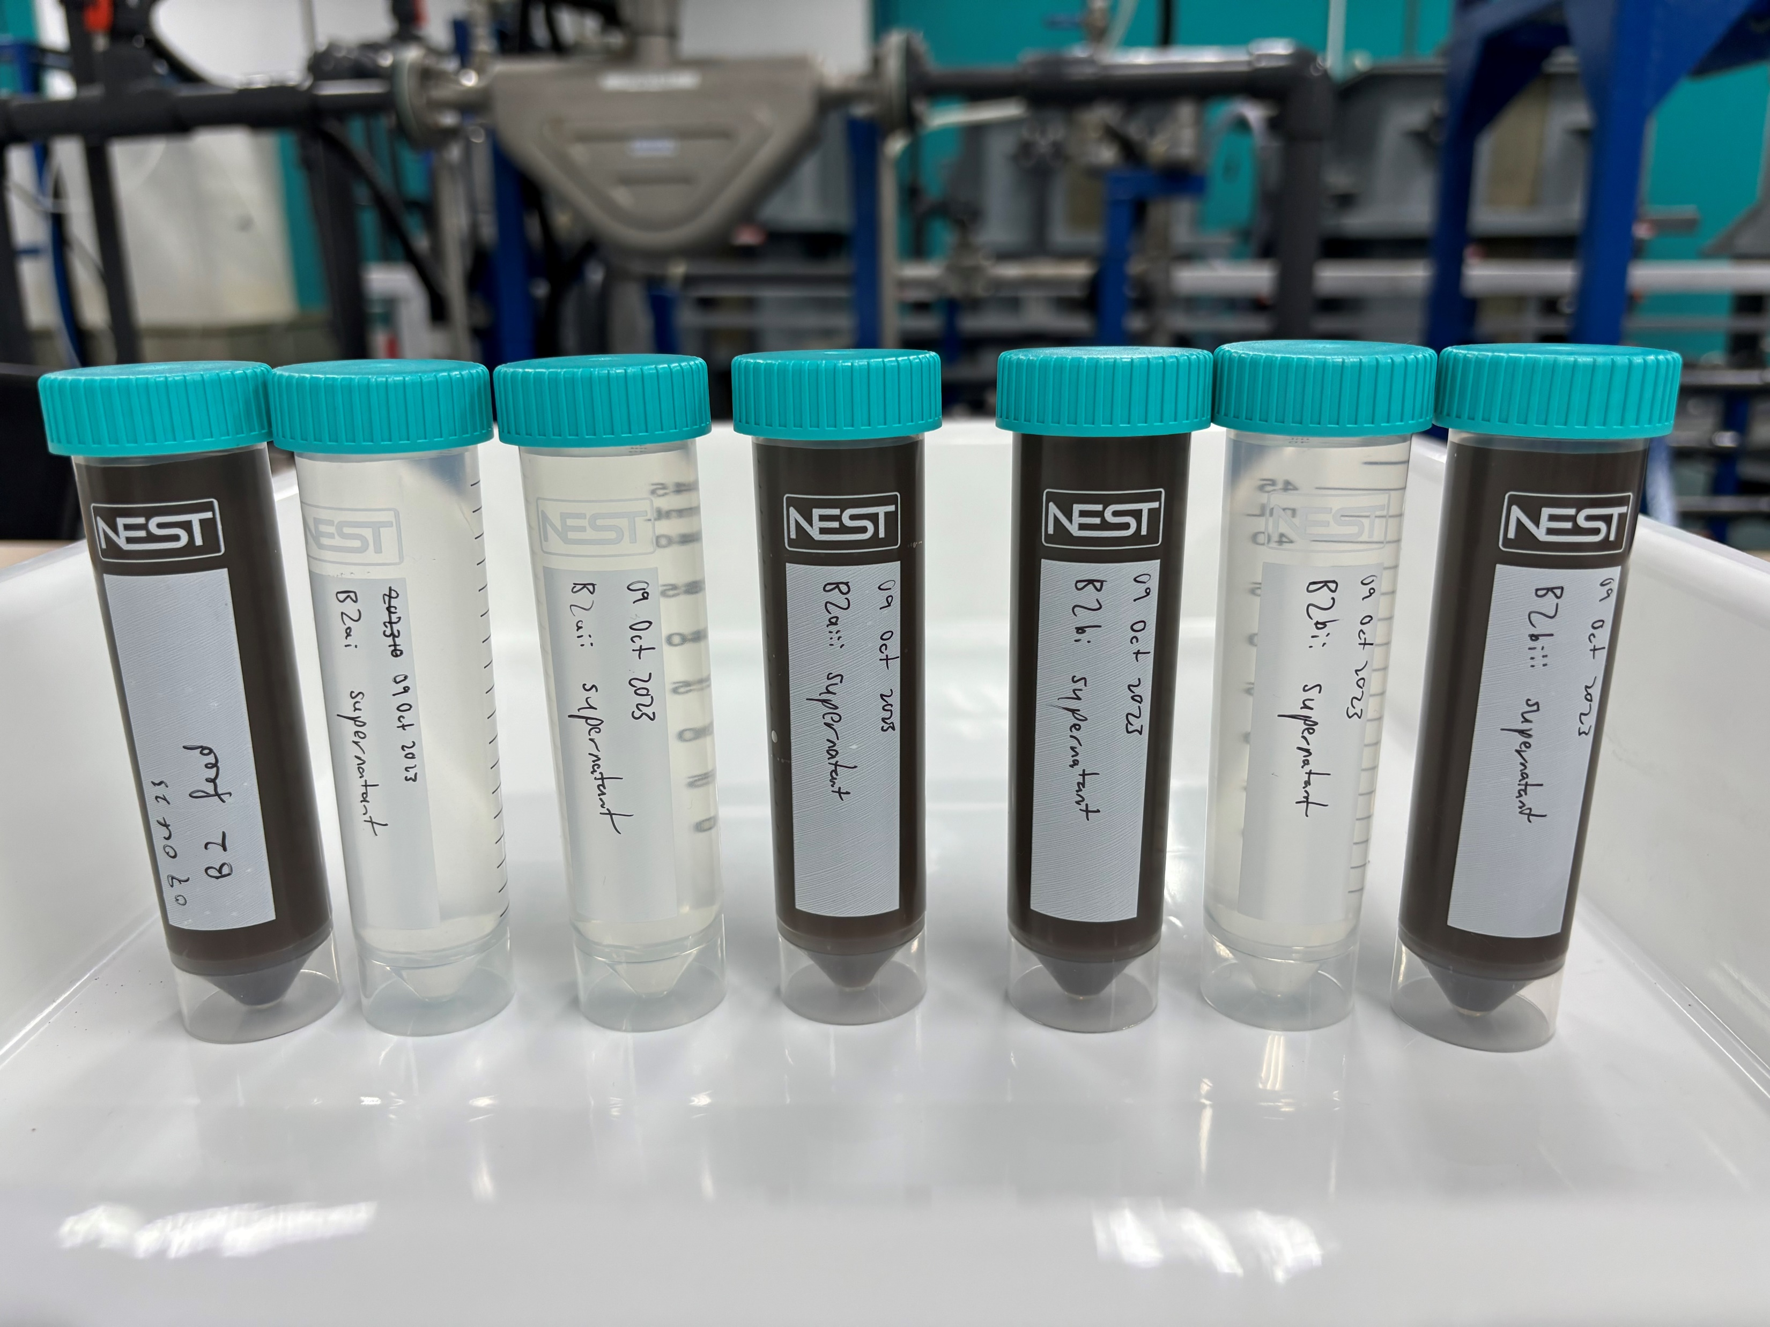
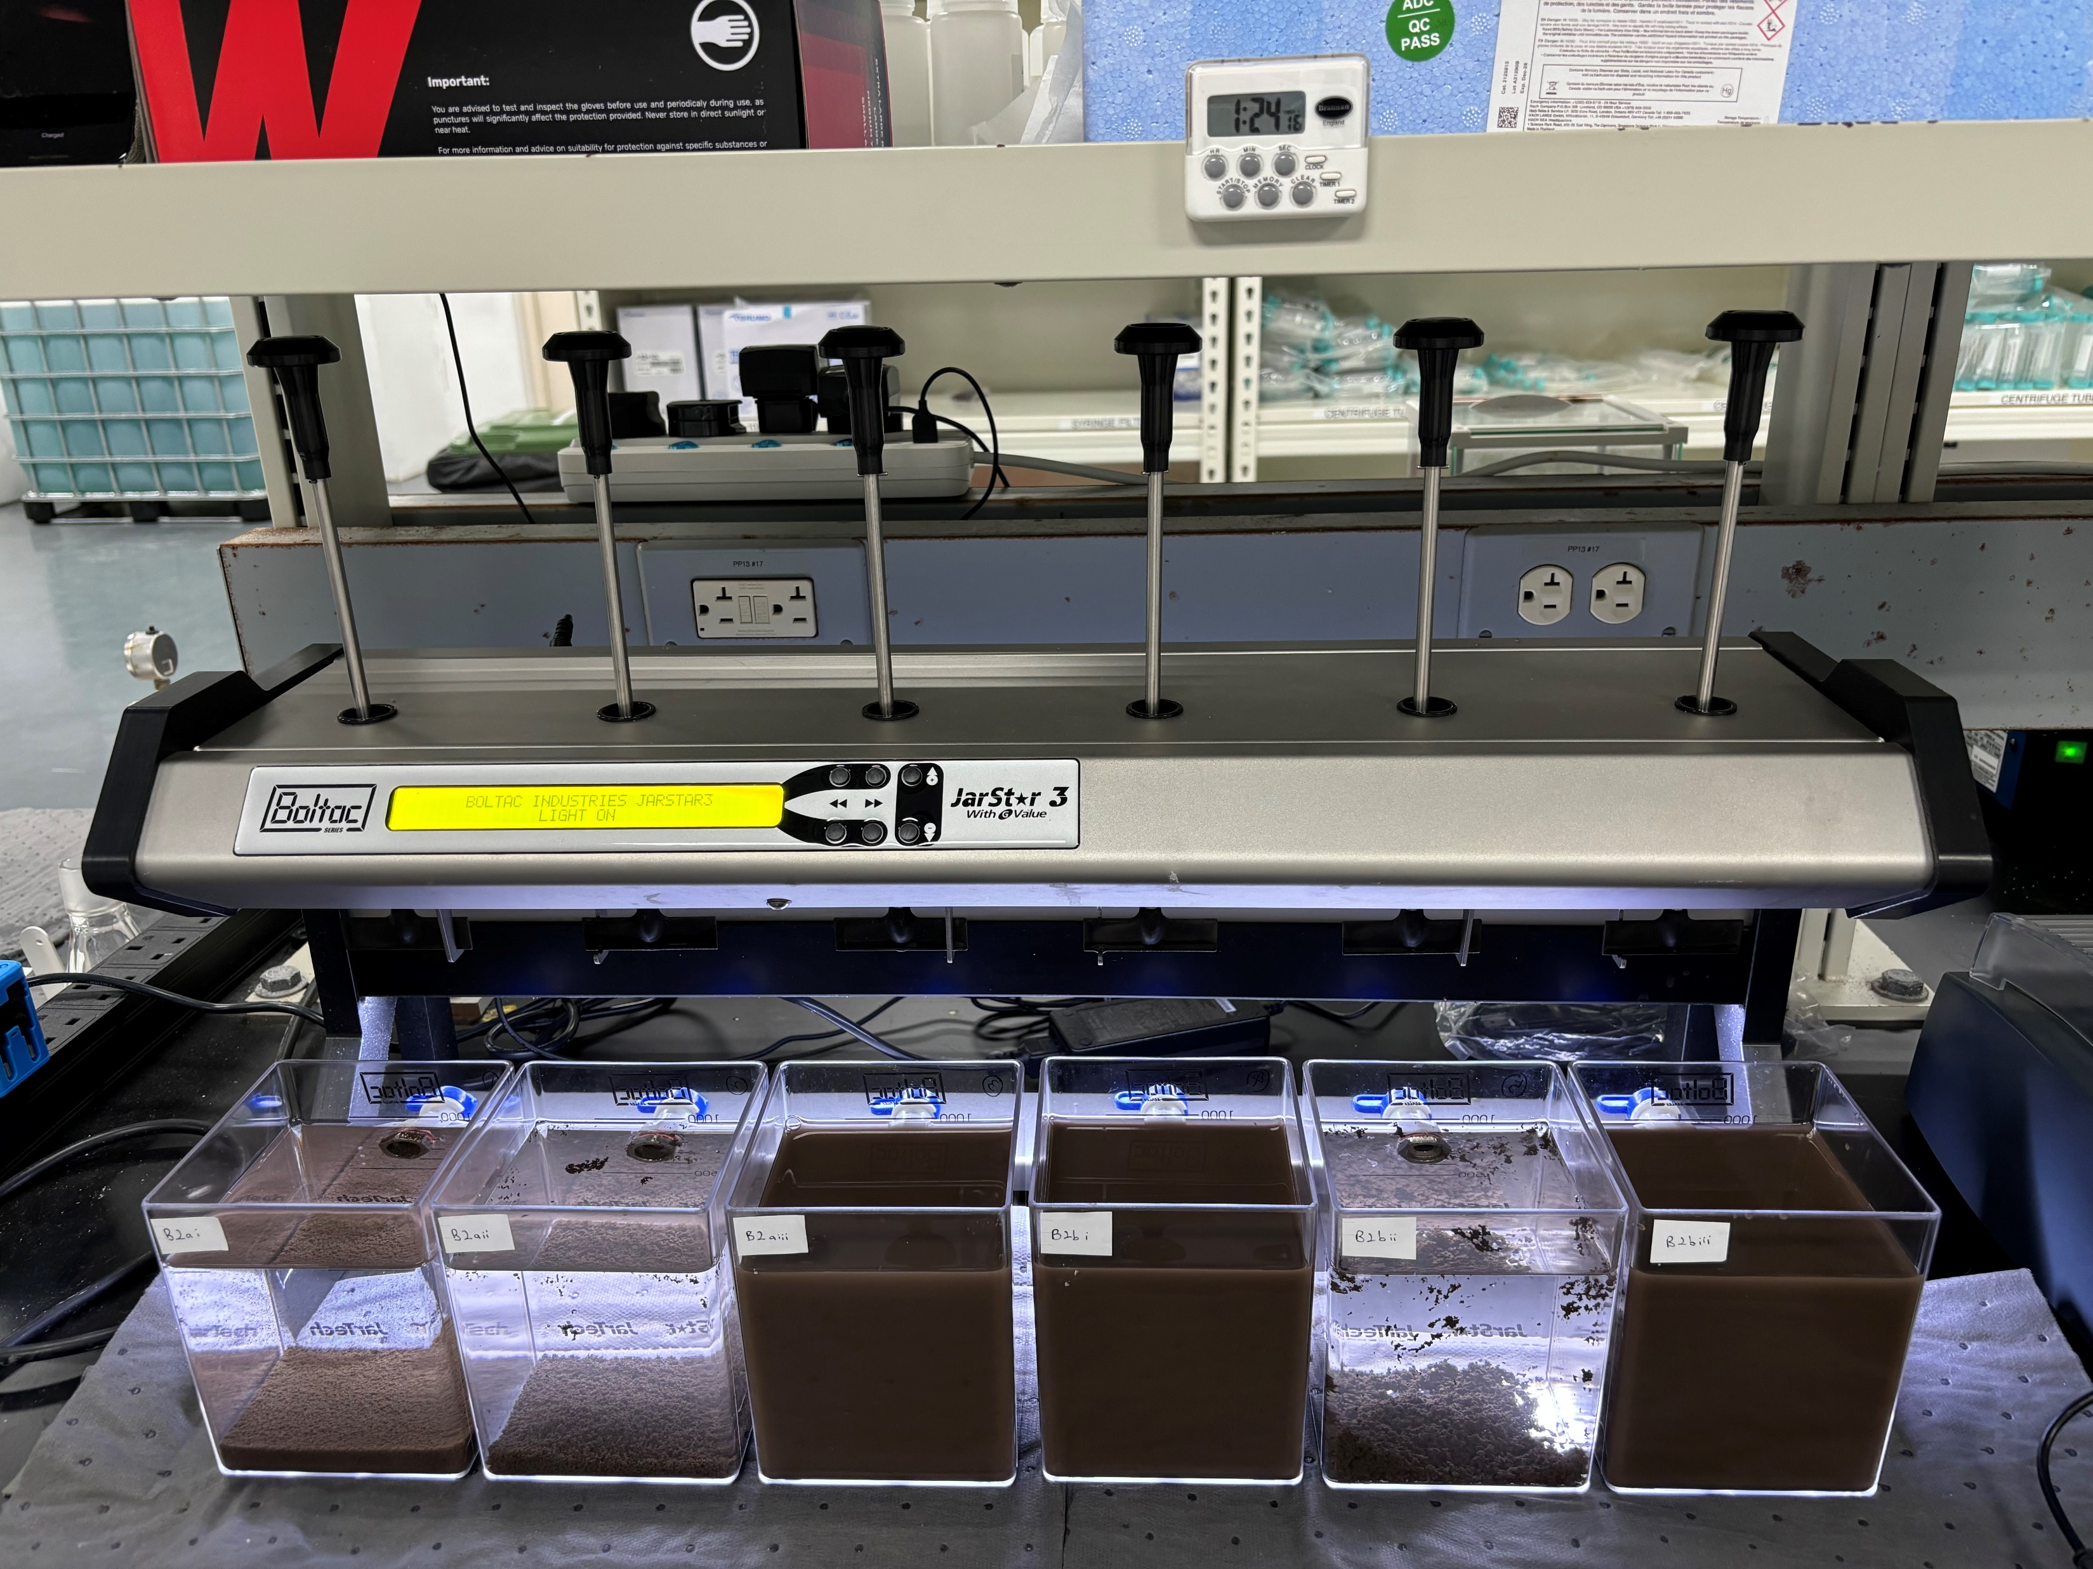
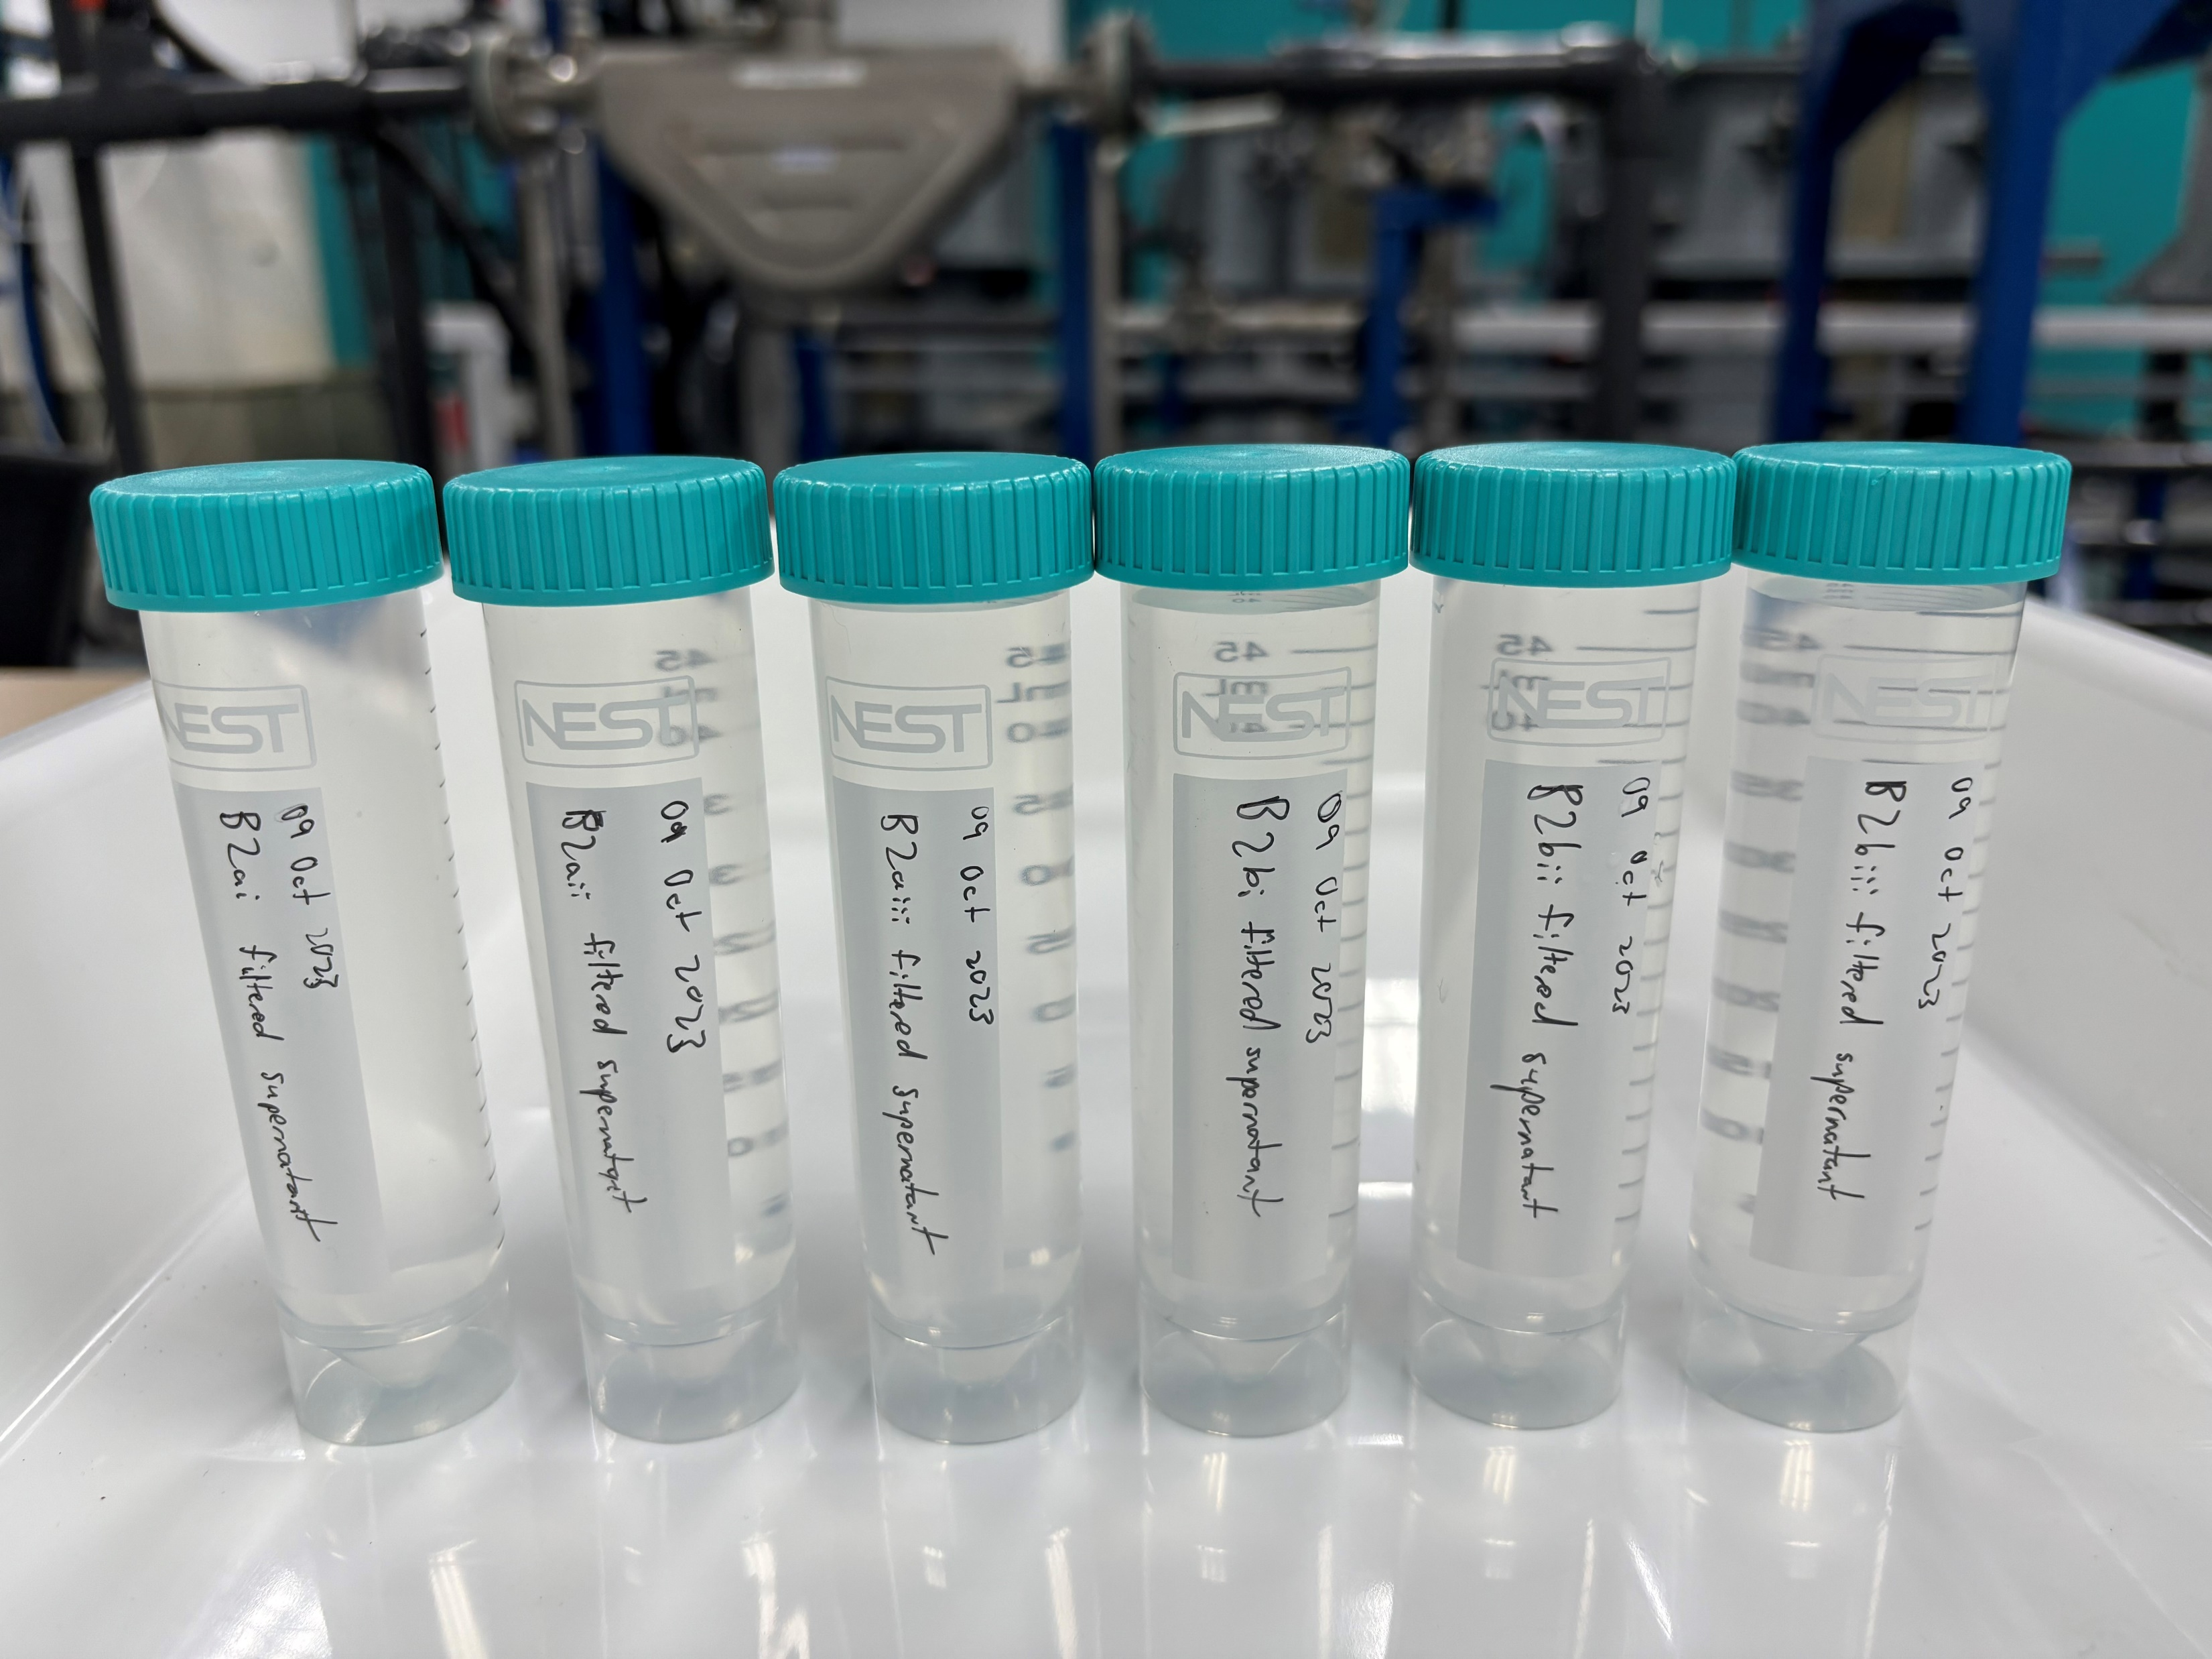
Experiment – Combo Feed with PAC
Initial
Final
Collect samples for analysis: (i) Feed (Control); (ii) Supernatant; (iii) Filtered Supernatant (0.45μm)
PAC 50-250mg/L
pH 5.5-8.5

Slide 9
Results – Combo Feed with PAC
 | Control | PAC Dose-1 |  | PAC Dose-2 |  | PAC Dose-3
 | Feed | Supernatant | *Filtered Supernatant | Supernatant | *Filtered Supernatant | Supernatant | *Filtered Supernatant
pH | 6.76 | 5.2 | 5.34 | 5.76 | 5.6 | 7.98 | 8.86
Turbidity, NTU | 6,900 | 5.72 | 0.123 | 22.1 | 0.354 | 6,380 | 1.2
TSS, mg/L | 3,620 | 3 | <3 | 8 | <3 | 3,360 | <3
Total Silica, mg/L | 570 | 157 | 156 | 149 | 144 | 561 | 140
Conductivity, μS/cm | 34.4 | 130 | 128 | 179 | 181 | 204 | 206
*Filtered Supernatant (0.45μm)

Slide 10
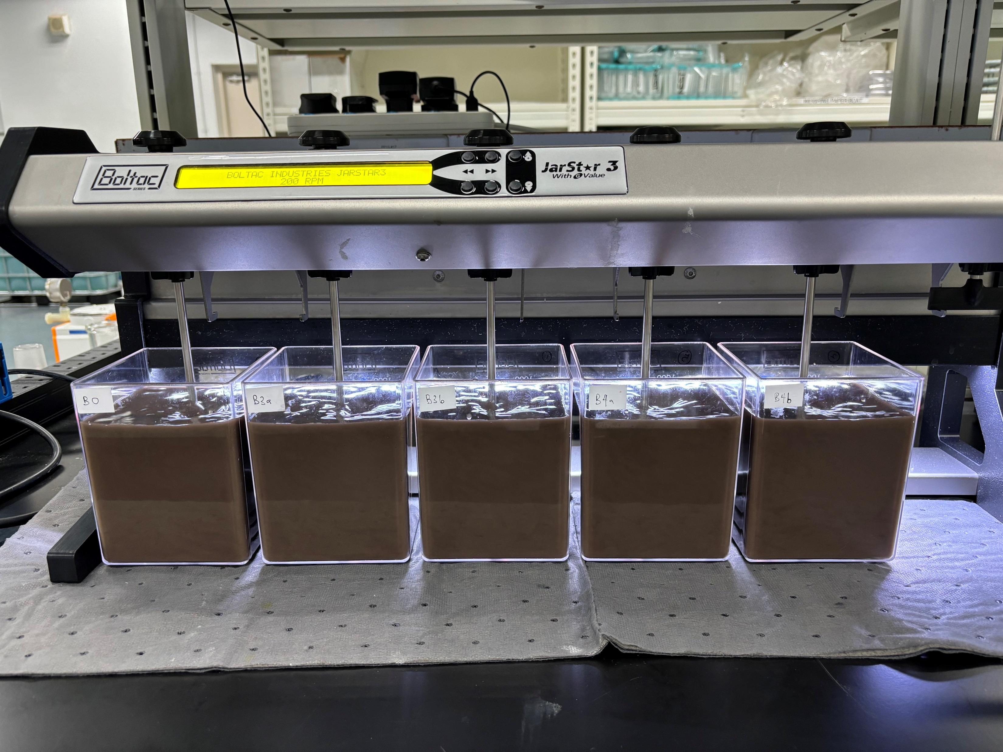
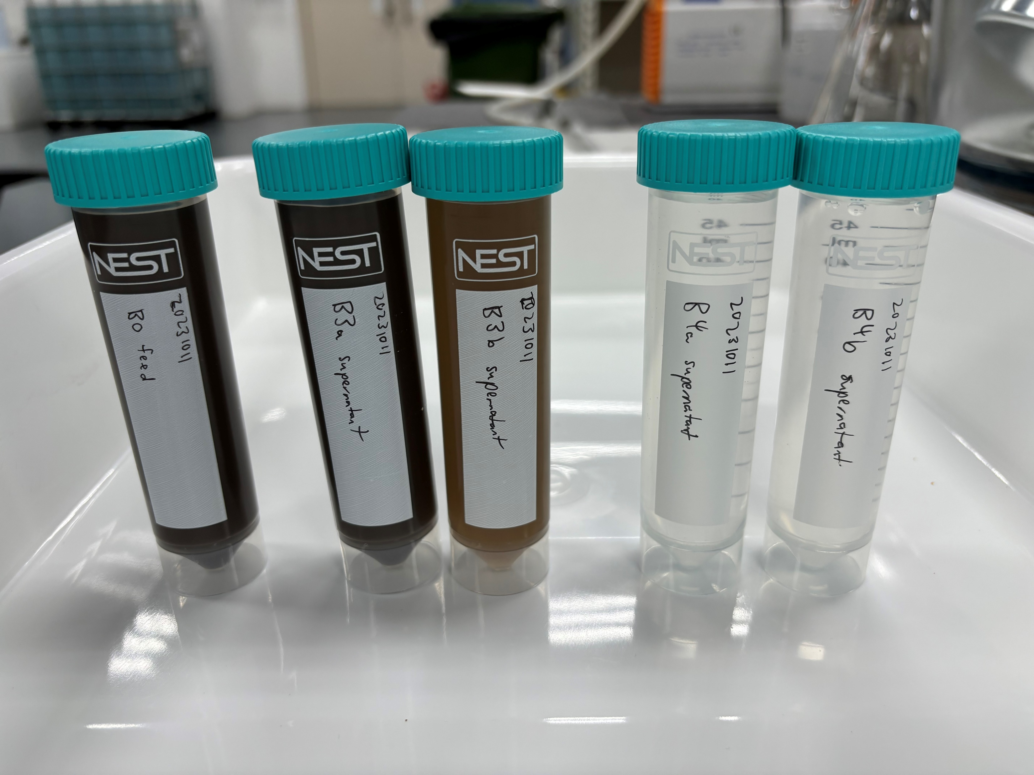
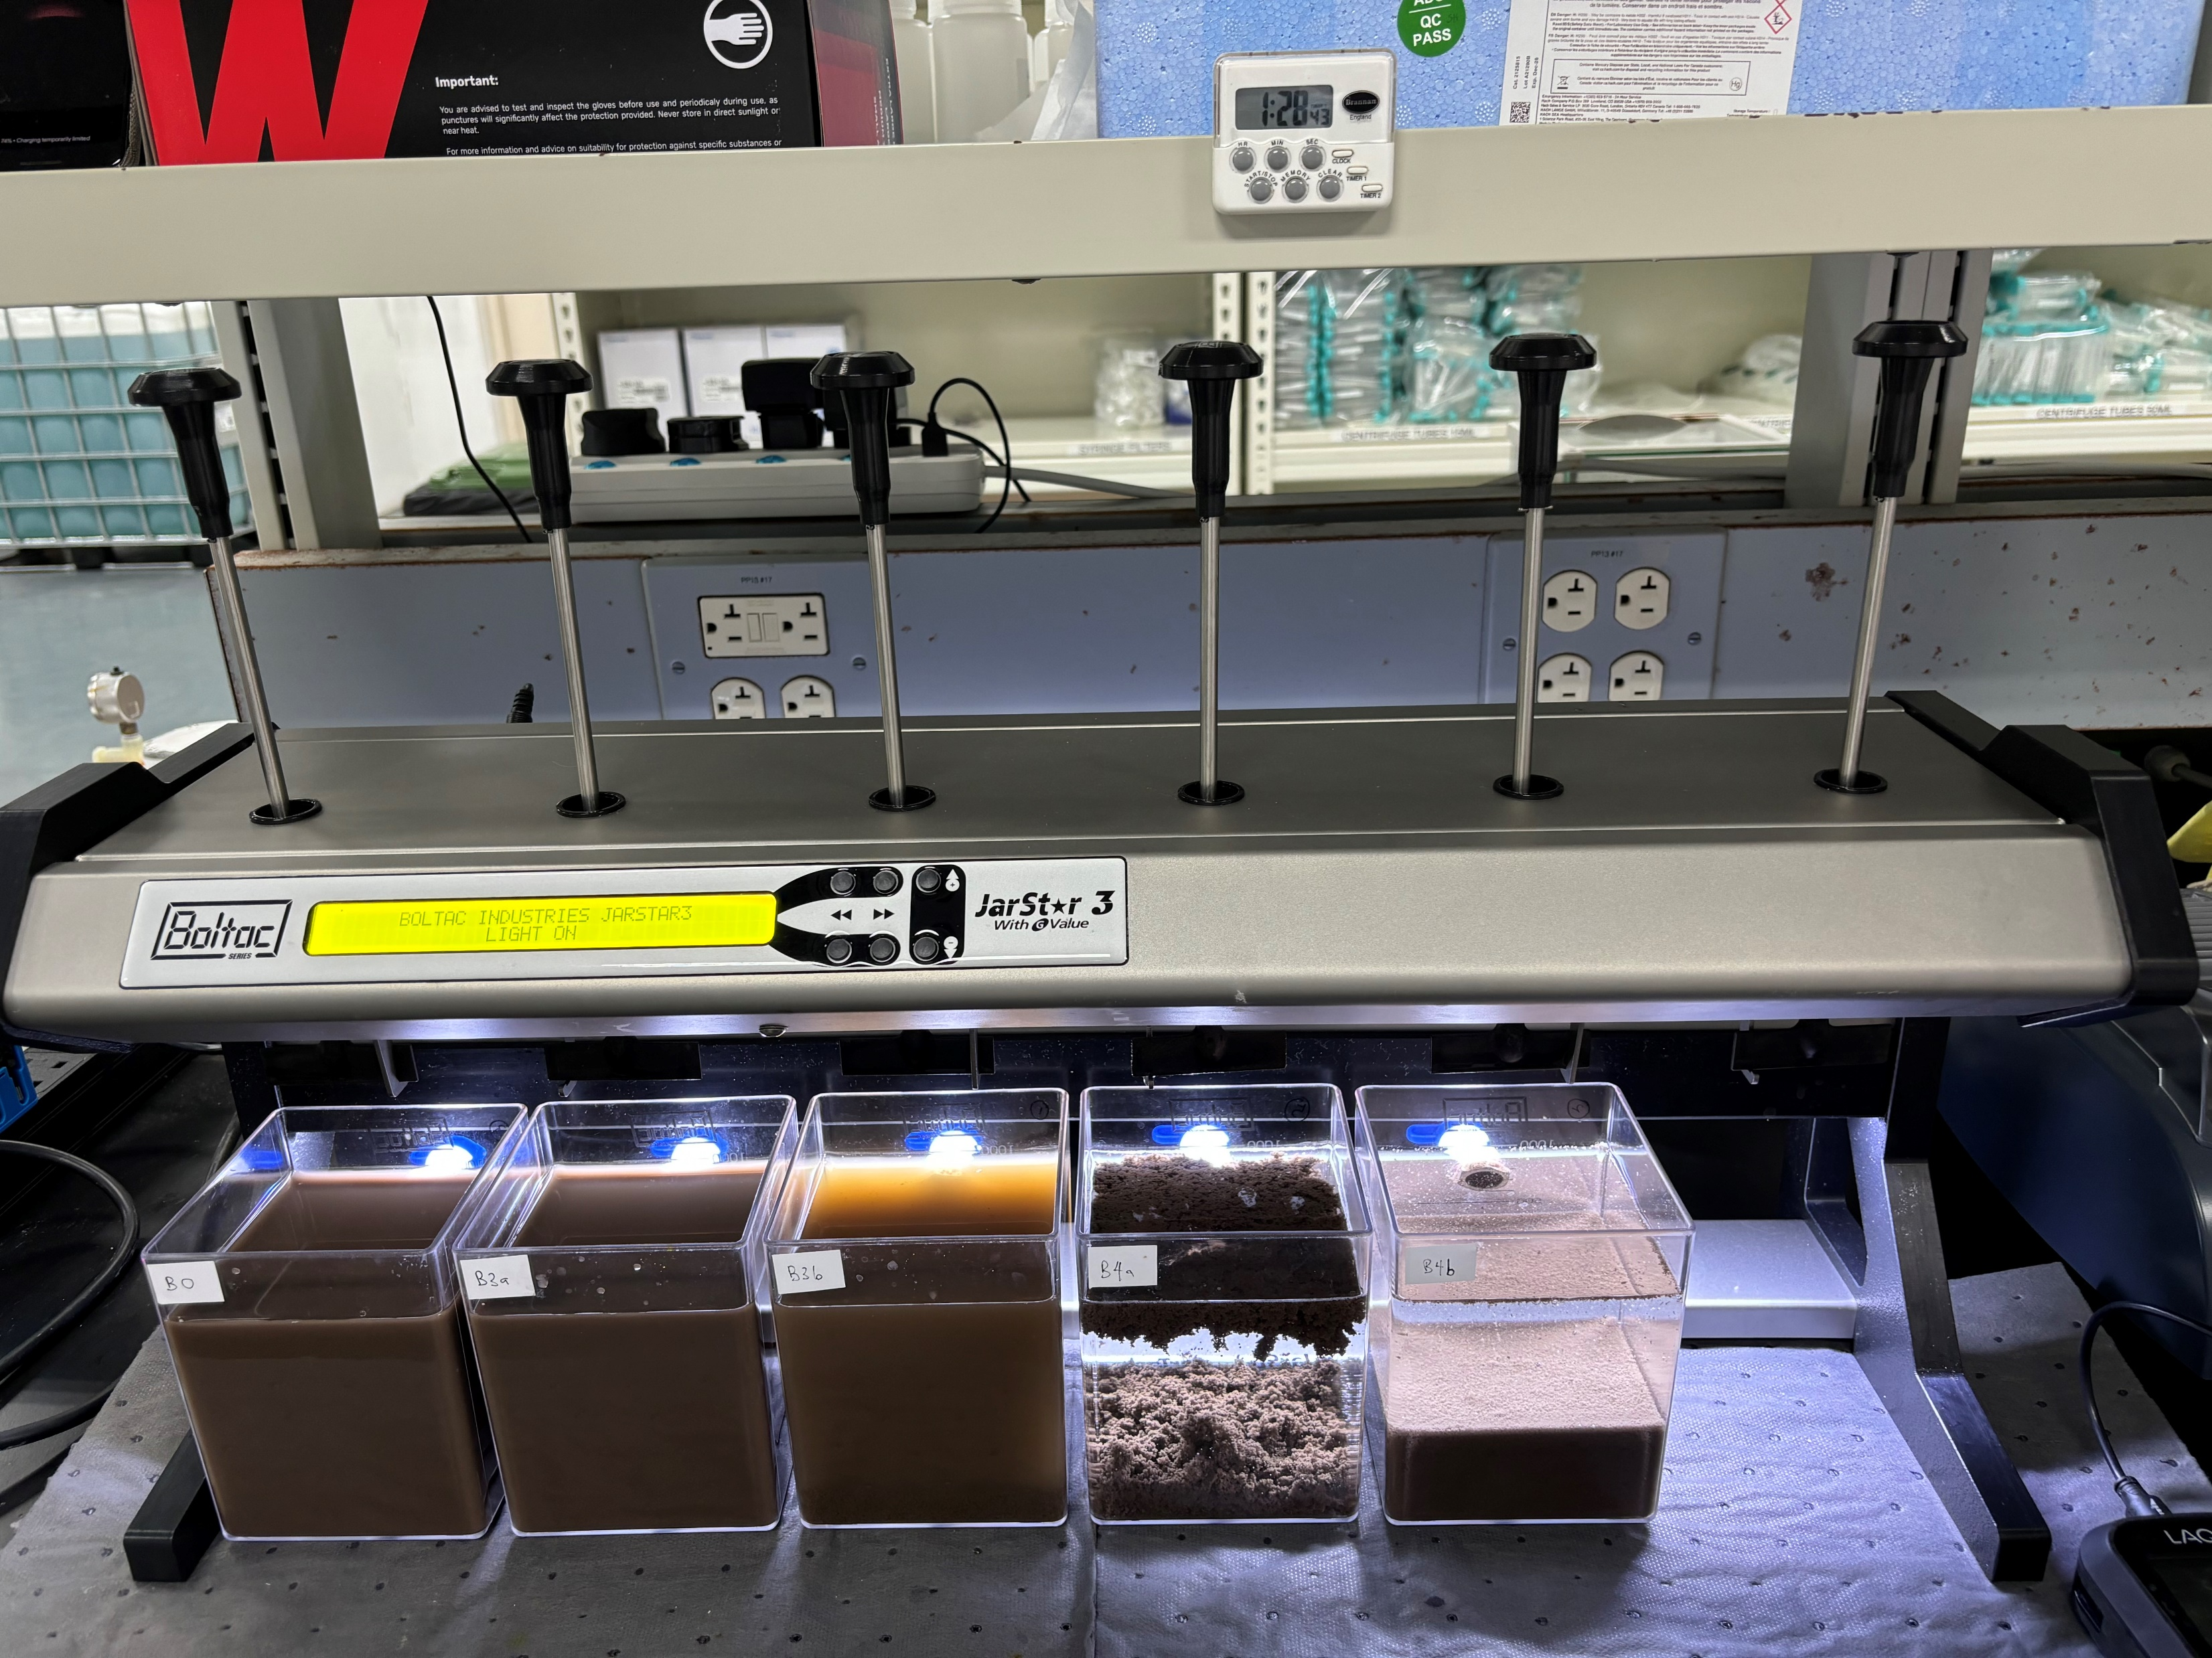
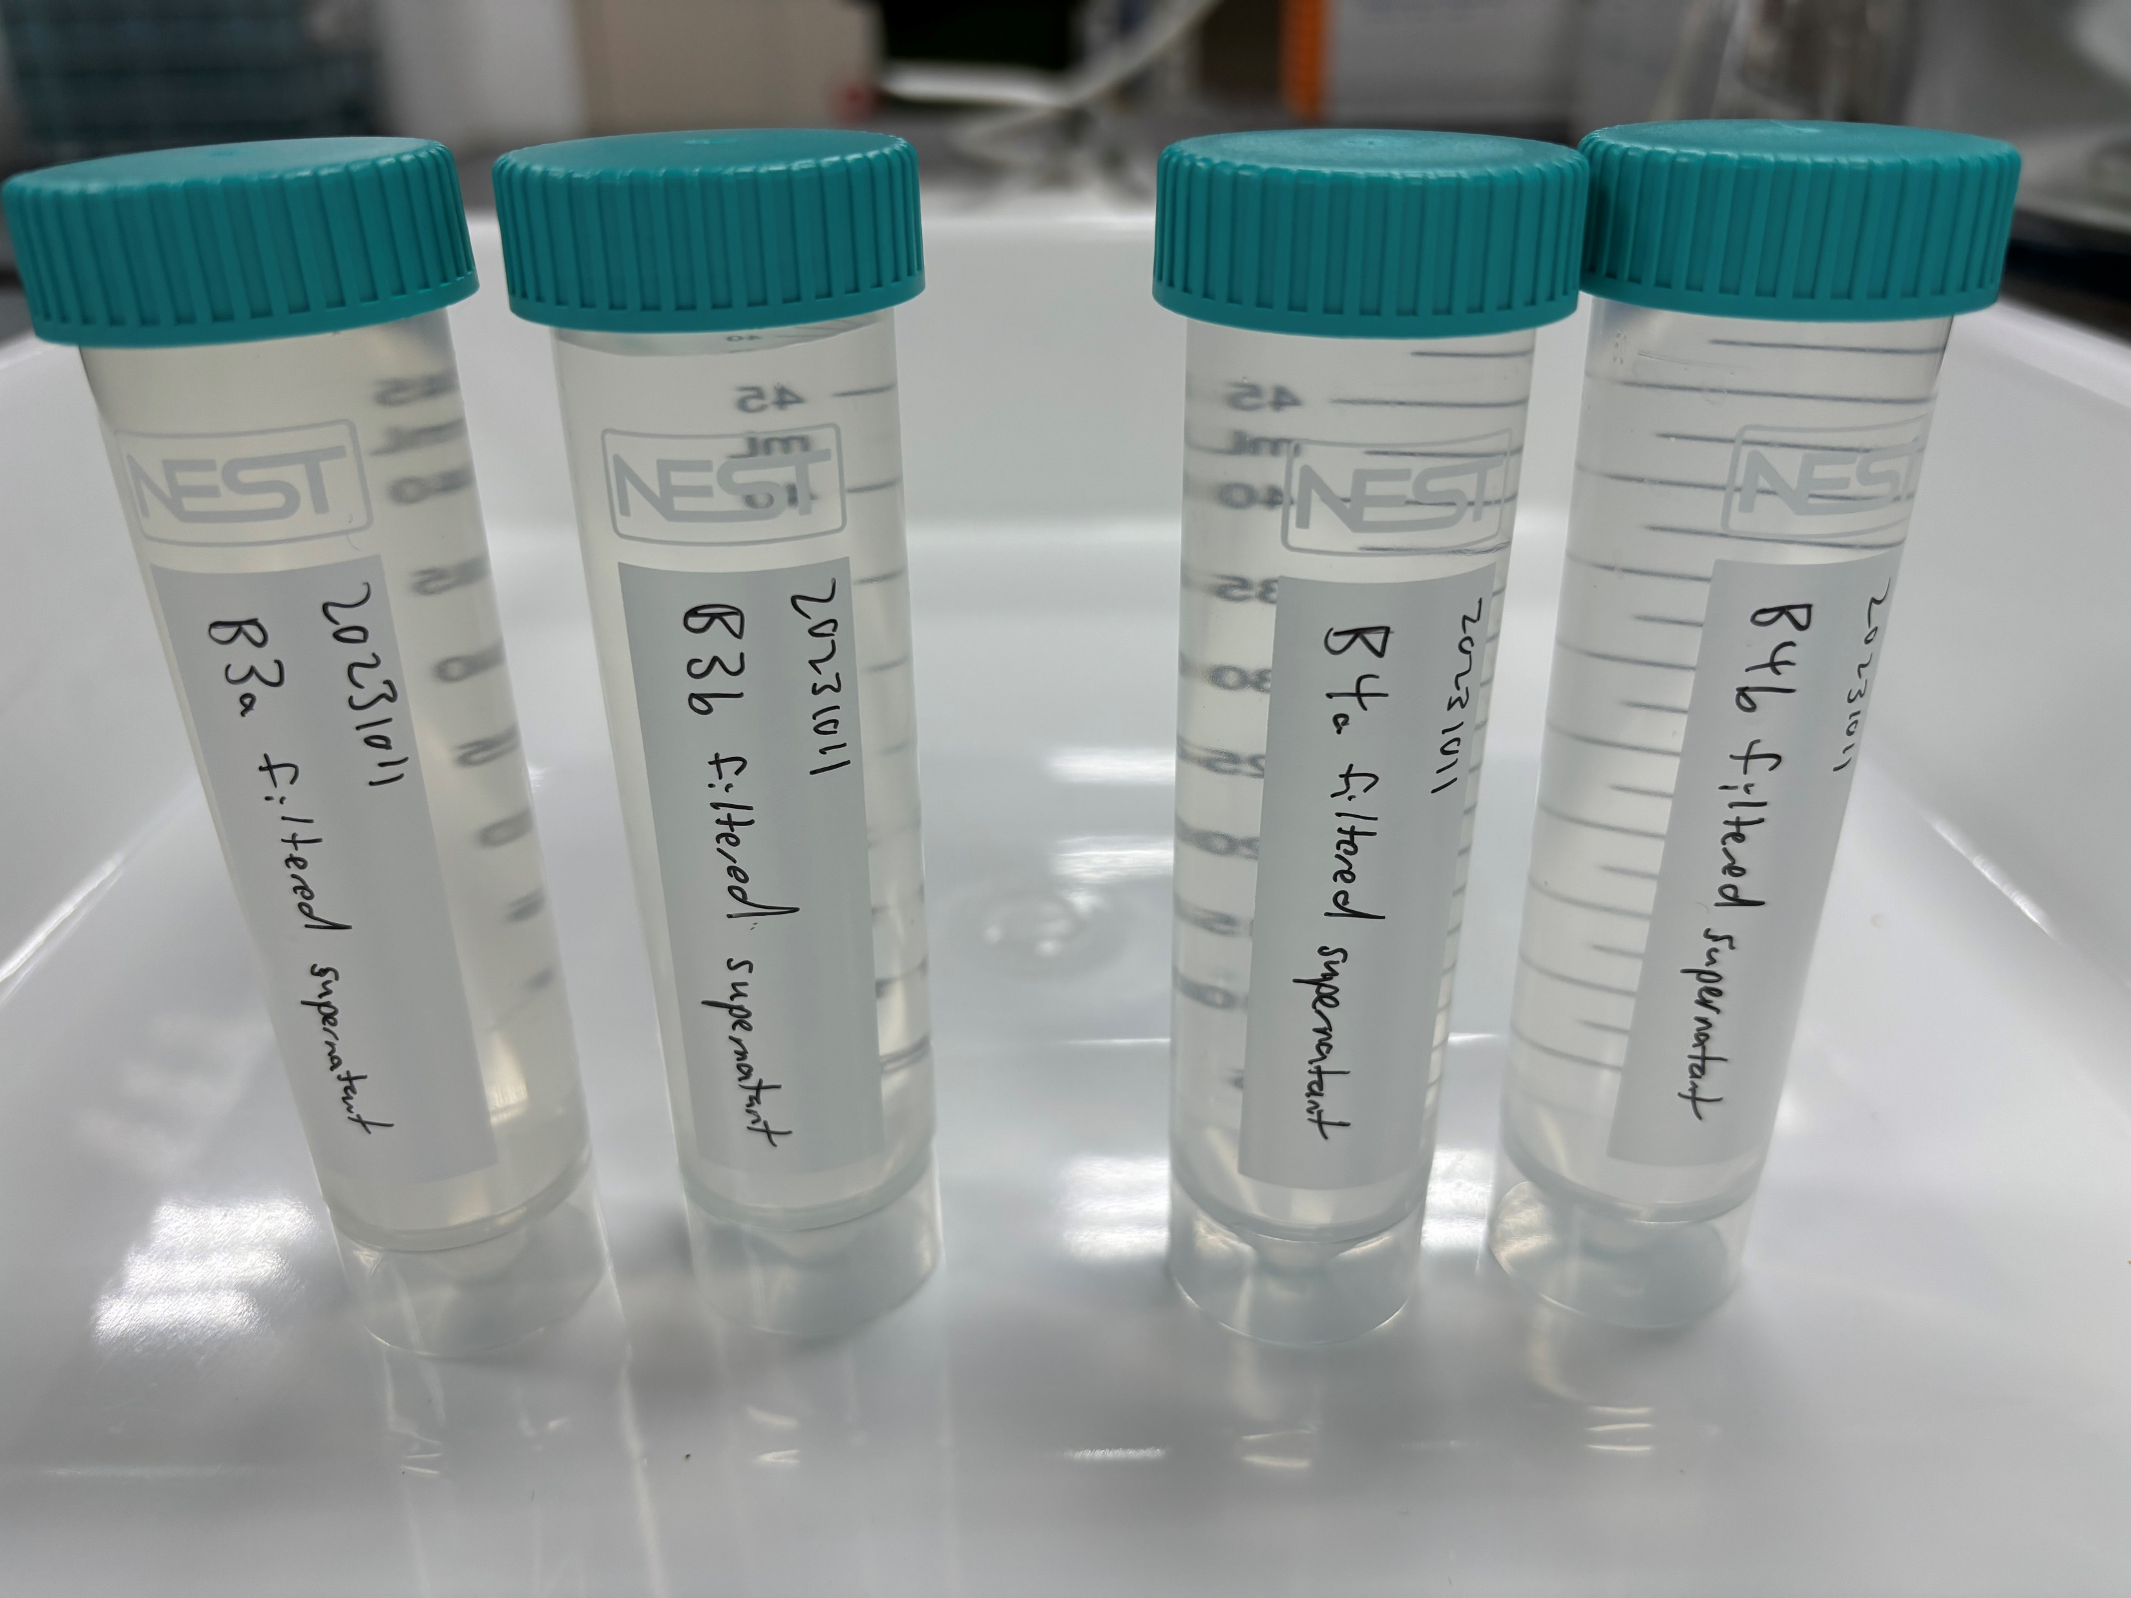
Experiment - Combo Feed with FeCl3/MgCl2
Initial
Final
Collect samples for analysis: (i) Feed (Control); (ii) Supernatant; (iii) Filtered Supernatant (0.45μm)
FeCl3 350-950mg/L
pH 8.5-9.5
MgCl2 650-2,400mg/L
pH 10.5-11.0

Slide 11
Results – Combo Feed with FeCl3 / MgCl2
 | Control | FeCl3 Dose-1 |  | FeCl3 Dose-2 |  | MgCl2 Dose-1 |  | MgCl2 Dose-2
 | Feed | Supernatant | *Filtered Supernatant | Supernatant | *Filtered Supernatant | Supernatant | *Filtered Supernatant | Supernatant | *Filtered Supernatant
pH | 6.01 | 8.46 | 8.35 | 7.65 | 7.35 | 10.6 | 10.7 | 10.7 | 10.7
Turbidity, NTU | 6,760 | 6,850 | 30.4 | 939 | 10 | 5.82 | 0.336 | 12 | 0.232
TSS, mg/L | 3,530 | 3,450 | 11 | 500 | <3 | <3 | <3 | 6 | <3
Total Silica, mg/L | 596 | 648 | 133 | 144 | 36.6 | 9.45 | 9.22 | 5.56 | 4.06
Conductivity, μS/cm | 33.6 | 430 | 432 | 1,843 | 1,858 | 1,490 | 1,473 | 4,670 | 4,710
*Filtered Supernatant (0.45μm)
Note: Further dilution with BGA RO Conc to lower feed conductivity to downstream RO process

Slide 12
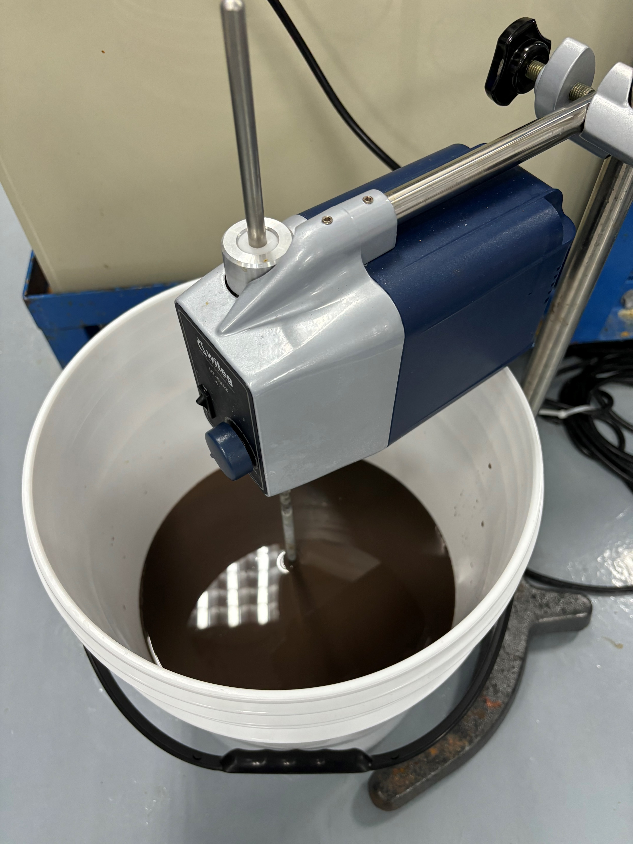
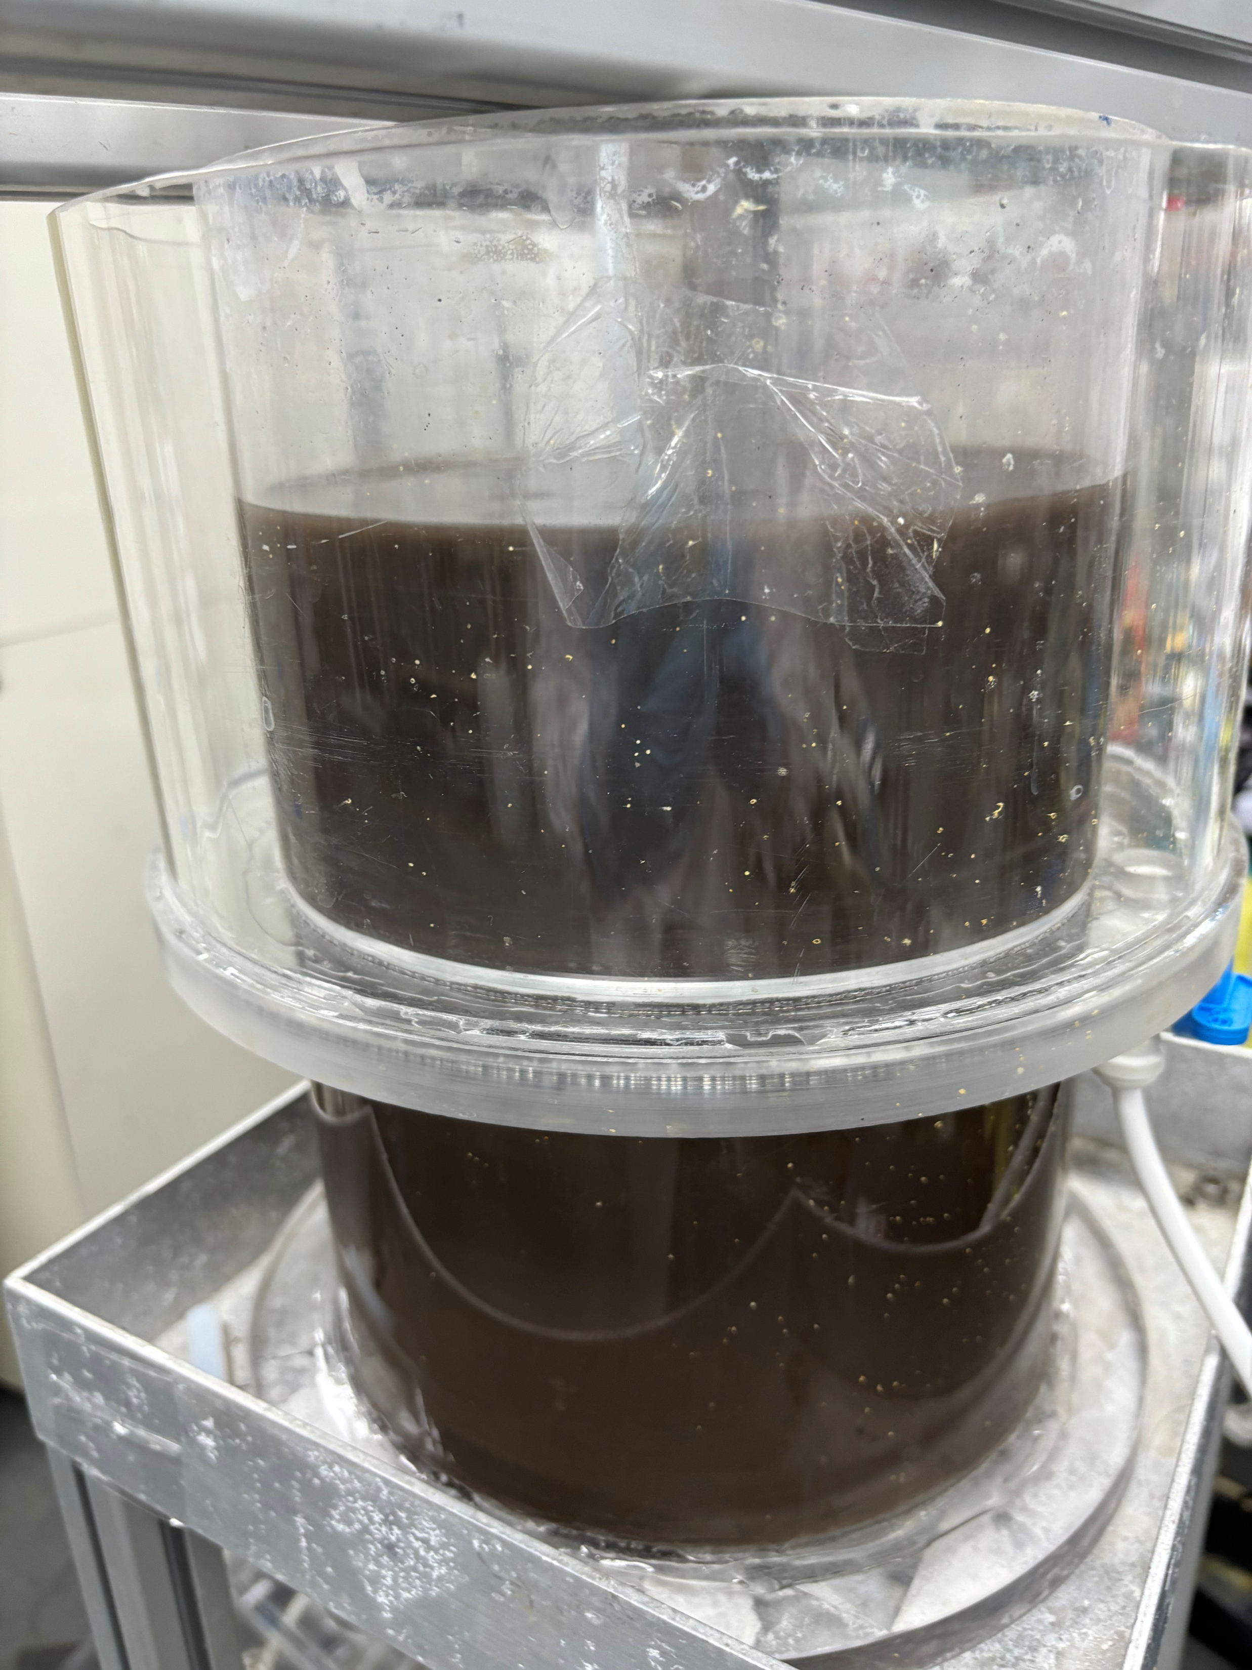
DAF Trial
Coagulation of combo feed using PAC
Transfer to DAF → no separation observed

